Slide 1

Starting HH Interviews in CAPI
Interviewers

Slide 2
What?
Why?
When?
Who?
Where?
Beginning a household interview (Module 1 & 2) using CAPI menus
Simplicity and organization of work
After being assigned a household and locating it
Interviewers
In the households of respondents
Notes:
Note that supervisors can act as interviewers at any time
Modules 1 and 2 are the start of a household interview – must be completed before any other modules

Slide 3




Steps to starting a HH interview
Locate desktop icon and open CAPI system
Choose household to interview
Choose “result” of interview and initiate questionnaire
Begin interview!

Slide 4
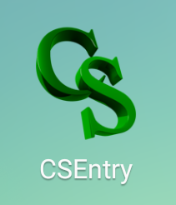
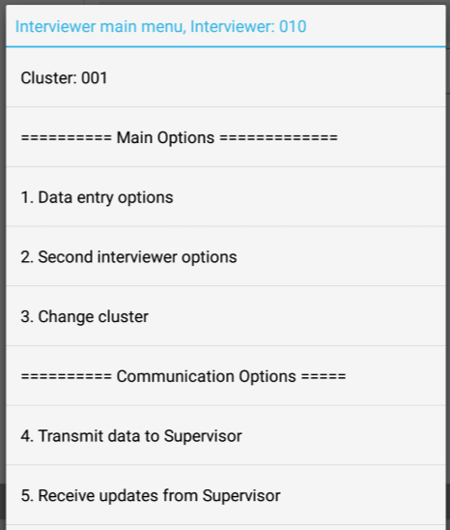
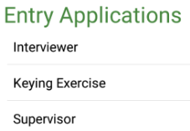
Open CAPI system
Click on CSEntry icon:
Check identifiers!

Slide 5
Choosing a household
From interviewer main menu, choose option 1:
All interviews will be found in this option!
Keep in mind!

Slide 6
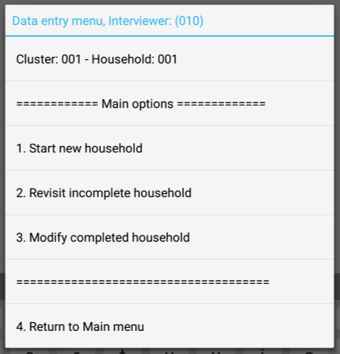
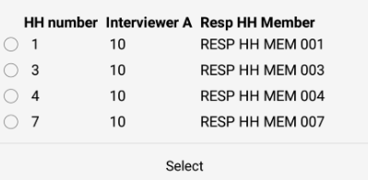
Choosing a household
Choose correct household:
Is the household a:
New household? (1)
Incomplete household? (2)
OR a call-back? (2)
Completed household? (3)
Notes:
Choose the appropriate option from main menu – new, partial, or modify
Choose who has the HH
Pick the right name, address
ASK: What do you do if the HH you want isn’t there?

Slide 7
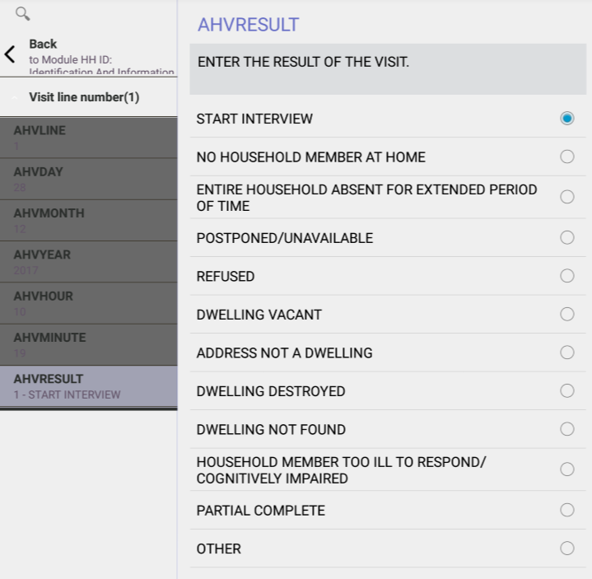
Initiating a questionnaire
Question name
BLACK TEXT Instructions to interviewer
Blue text
Read out loud to respondents
Automatically entered by CAPI
Current question
Notes:
Note that a GPS reading will occur automatically – interviewers should allow the GPS data to be collected
Dark grey variables are completed, light grey variable is current question
Explain BLACK ALL CAPS TEXT vs. Blue italicized text – instructions vs. questions to read outloud

Slide 8

Initiating a questionnaire
Begin a new household interview
Choose “result” of the visit:
Options for an incomplete interview
Notes:
Review of HH result codes from paper training… what’s different? Choose (1) to begin the interview
ASK – what code if nobody is home? If nobody home, choose (2)
ASK – what code if you will make a call back? If making an appointment, choose (4)

Slide 9


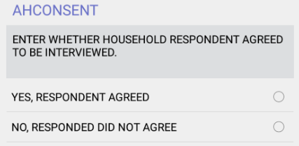

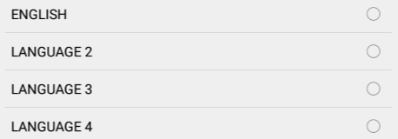
Initiating a questionnaire
Choose languages:
Choose result of paper consent:
Notes:
Notice black instructions – why is consent not asked on tablet in blue?
Because consent forms are on paper – interviewer will fill in result of consent on paper…

Slide 10
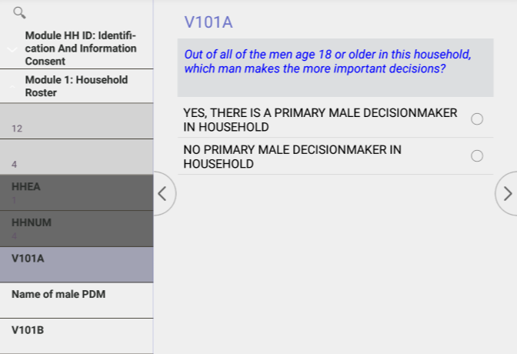

Begin HH interview!
Questions, instructions
Navigation buttons
BLACK – instructions for interviewer
Blue – read out loud respondent
Notes:
Buttons – navigation (or swipe left/right)
Reiterate question text

Slide 11
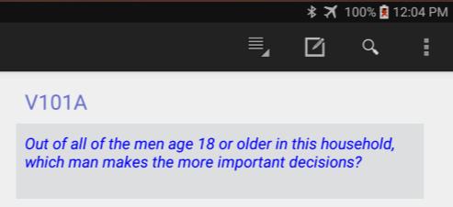
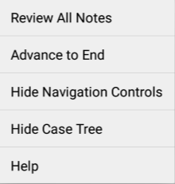
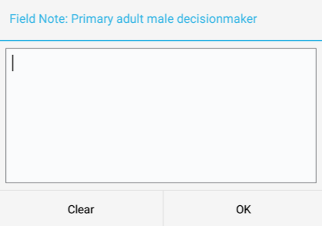
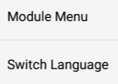
Begin HH interview!
Notes:
Navigation bar –
Module Menu – after completing modules 1,2, this will allow you to navigate to other modules and to save/quit an interview. Explore more later!
Switch language – if you need to switch language of interview, don’t translate on the fly! Switch languages here…
Field notes – HIGHLY ENCOURAGED! Click this on the question you want to make a note about…
Other options – explain! Review all notes shows all notes you have taken, advance to end sends you to latest question completed in questionnaire, navigation controls are the arrows on the sides of questions, case tree is the menu on the left that shows all questions, help is help!

Slide 12


Demo Time
Household schedule paper interview
Demonstration of CAPI entry with paper
Interviewers enter paper interview in their system
Using own FIRST household assigned
1
Paper HH entered into first CAPI HH
Notes:
Content expert will go over HW answers – CAPI expert will demo entry on their computer
Interviewers will then enter HW
Ask interviewers to identify their first household “assigned to me” – via demo on your computer
Things to make sure to note during entry of HH schedule – which is done with demo on facilitator laptop while class follows along on their tablets:
Household Schedule
HH head is first
Go through each question
Relationship codes pop up
Name inserted into follow up questions
HH respondent chosen at end – ASK: why? Who gets to be in the list?
2A, 2B, 2C – if yes, go back
Eligibility – How does this differ from paper?

